Slide 1
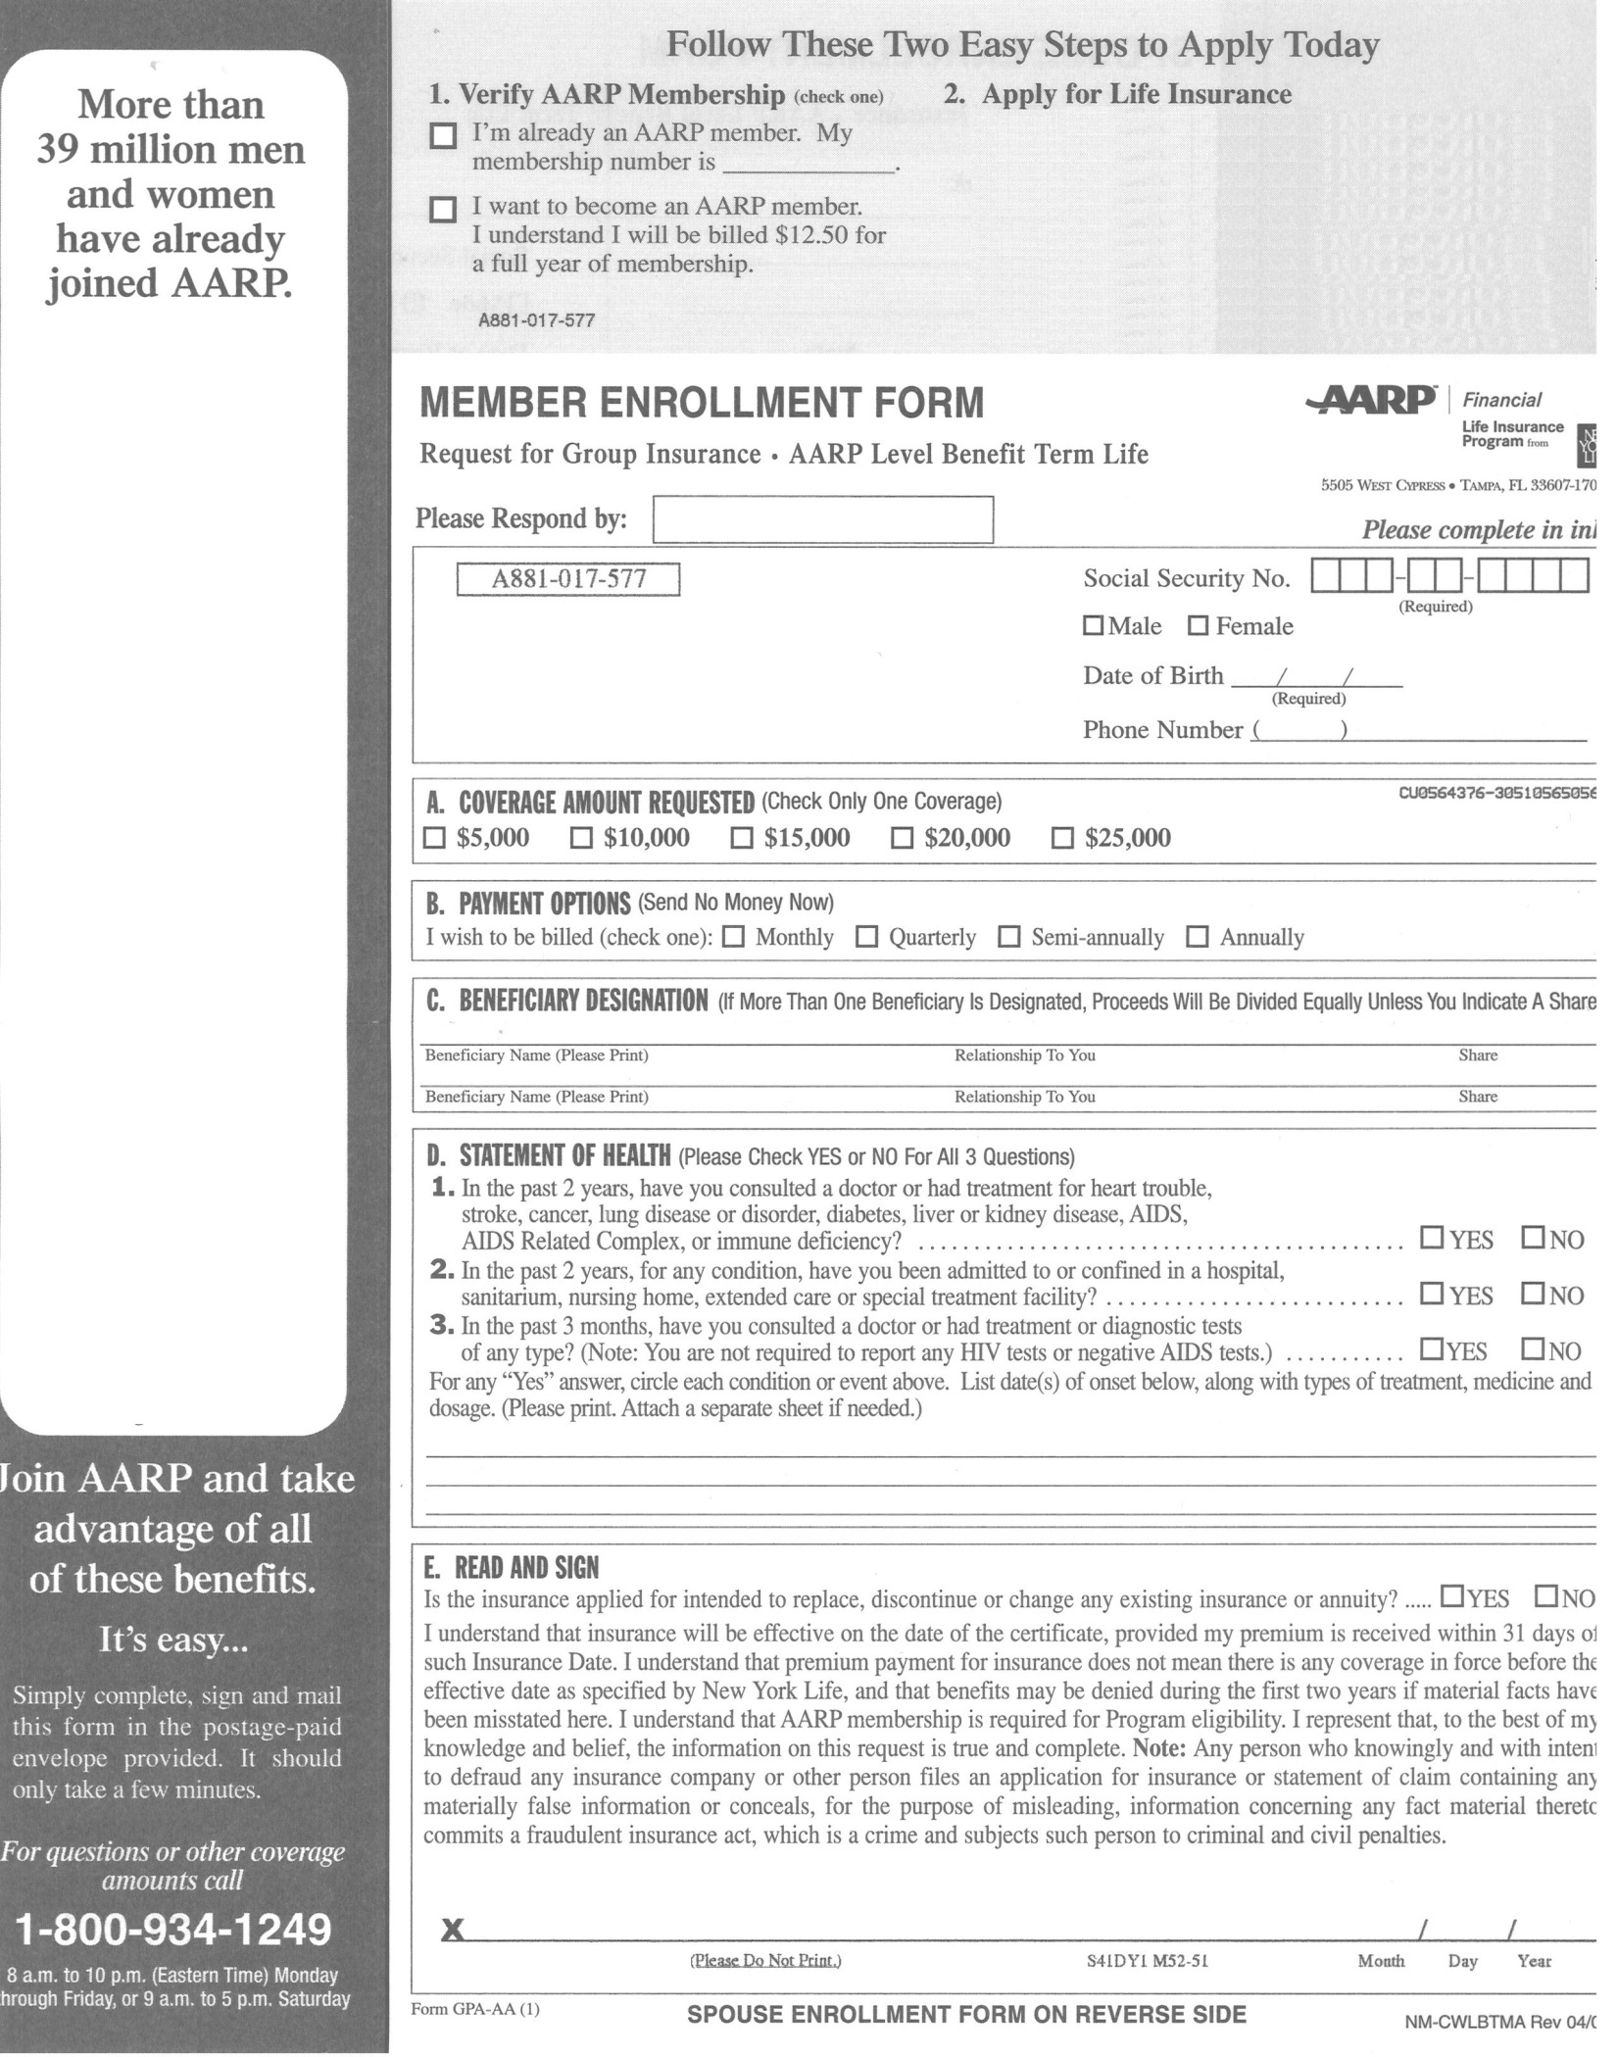
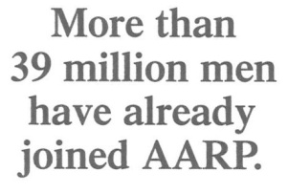
If you’d like to apply for life insurance now, NOW IS a good time. You’ll never again be healthier, more energetic, have both eyes, or have as much money as you do right now. Let’s face it, today is the last best day of your life, and your plants and animals know it. Save them. You never know when your employer will pull the plug on the gravy train.
So why not take advantage of that fantastic AARP benefit NOW?
It only takes 55 minutes to fill out the form now, assuming you can read it. You never know when one eye will fall out and you won’t be able to see the table in front of you.
You’ll be able to take advantage of so many AARP benefits like city-wide travel, drug discounts, Rap music lessons, ambulatory conveniences and more.
AARP membership gives you access to a unique community of other blue-hairs just like yourself. Just imagine being a part of the Quilting Club, Checkers Champs, Walker Wielding Women, and many more exciting clubs and activities.
ACT NOW!
(while you still can)
May 29, 2009
Ms. Sue Templin
W125S8535 Country View Ct
Muskego, WI 53150
x
$250,000,000
x
Janet Jastroch
Psychiatrist
Not with any of YOUR kids
Kay Gregorich
The Wheels on the Cart
100%
eye disease
x
x
x
(fogetaboutit)

Slide 2
